Slide 1

Security in Cloud using Cryptography – A Pivotal Approach
Presented by
Gada, Sharanya – Team Lead
Alapati, Ravindranath Chowdary Dasari, Venkata Reddy
Palem, Kishore
Perumalla, Venkata Krishna Meher Shaik, Khadar

Slide 2
Agenda
Cloud Computing
Cryptography
Elliptical Curve Cryptography
Blowfish
Outcomes
Conclusion

Slide 3
Cloud Computing
Cloud computing is an Internet-primarily based computing version that affords numerous sources via Cloud Service Providers (CSP) to Cloud Users (CU) on call for foundation without shopping for the underlying infrastructure and follows a pay-per-use foundation.
It helps with virtualization of physical resources if you want to improve performance and accomplish more than one duty at the same time.
Cloud Computing Environments (CCEs) provide a variety of deployments to symbolize multiple clouds owned by an organization or institution.

Slide 4
Project Walkthru
Plain Text
Generate Keys using ECC
Encrypt plain text using Blowfish
Encrypt Key block using private key from ECC
Cipher Text

Slide 5
Elliptic Curve Cryptography
Elliptical Curve Cryptography is considered as one of the modern public-key cryptosystems based on algebraic structures of elliptical curves over a finite field.
It follows the asymmetric cryptosystems such as encryption, signatures, and key exchange.

Slide 6
Keys in ECC
Private keys in the ECC are in the range of the Elliptical Curve size which are 256-bit integers.
Private key: 0x51897b64e85c3f714bba707e867914295a1377a7463a9dae8ea 6a8b914246319

Slide 7

Public keys in ECC are EC coordinate points(x,y) laying on the curve.
They are compressed to just one coordinate (odd or even). Overall public key is 257-bit integer, and its corresponding private key is 256-bit.

Slide 8
Generator in ECC
The ECC cryptosystems define a special pre-defined (constant) EC point called generator point G (base point), which can generate any other point in its subgroup over the elliptic curve by multiplying G by some integer in the range [0...r].
The number r is called "order" of the cyclic subgroup (the total number of all points in the subgroup).

Slide 9
Finally, in the ECC cryptography the EC points, together with the generator point G form cyclic groups (or cyclic subgroups), which means that a number r exists (r > 1), such that r * G = 0 * G = infinity and all points in the subgroup can be obtained by multiplying G by integer in the range [1...r]. The number r is called order of the group (or subgroup).

Slide 10
ECC Walkthru
In ECC, you can get EC point P (corresponding public key) by multiplying fixed EC point G (generator point) by a specific integer k (k can be considered a private key).
Consequently, in ECC we have:
Еlliptic curve (EC) over finite field ᵓ=p
G == generator point (fixed constant, a base point on the EC) k == private key (integer)
P == public key (point)

Slide 11
Real time ECC Curves
Elliptic curves in the elliptic curve cryptography (ECC) may be presented in several forms
Weierstrass form of elliptic curve
y2 = x3 + a_x + b
Example Weierstrass curve used in ECC is secp256k1, which has the form y2 = x3 + 7
Montgomery form of elliptic curve:
_B_y2 = x3 + _A_x2 + x
Example Montgomery curve used in ECC is Curve25519, which has the form y2 = x3 + _486662_x2 + x
Edwards form of elliptic curve:
x2 + y2 = 1 + _d_x2y2
Example Edwards curve used in ECC is Curve448, which has the form x2 + y2 = 1 - _39081_x2y2

Slide 12
Example
Private Key:
b'8175f7cd524a59b6efbd447985ce5d97c546b319521ff236203970e50052c64
12
Public Key:
b'cf97a96568fee4ddb232f617fd5b9df2d2e5b90e68ba7f6d5129ea92d7d8f95e

Slide 13
Advantages
It is very fast to calculate P = k * G, using the well-known ECC Multiplication algorithm in time log_2(kw_), e.g. the "double and add algorithm". For 256-bit curves, it will take just a few hundred simple EC operations.
Calculating k = P / G is very slow (it is considered infeasible if k is large).

Slide 14
Smaller keys and signatures than RSA
Security
Fast key generation,
Fast key agreement
Fast signatures.

Slide 15
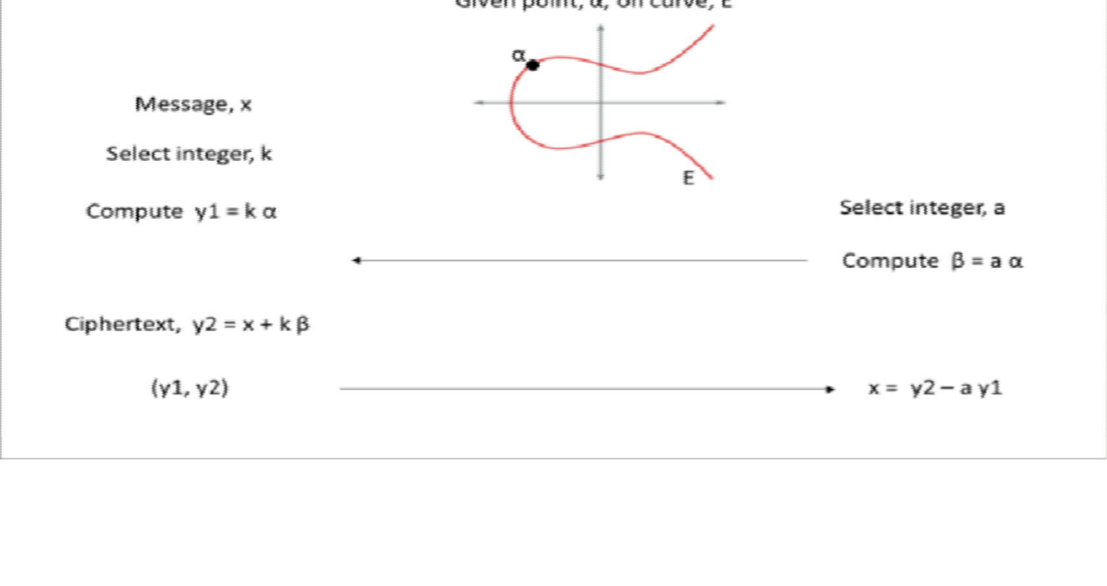
ECC Pictorial Reprsentation

Slide 16
Blowfish
Blowfish was designed in 1993 by Bruce Schneier as a fast, free alternative to existing encryption algorithms.
Blowfish is a symmetric encryption algorithm, meaning that it uses the same secret key to both encrypt and decrypt messages. Blowfish is also a block cipher, meaning that it divides a message up into fixed length blocks during encryption and decryption. The block length for Blowfish is 64 bits; messages that aren't a multiple of eight bytes in size must be padded.

Slide 17


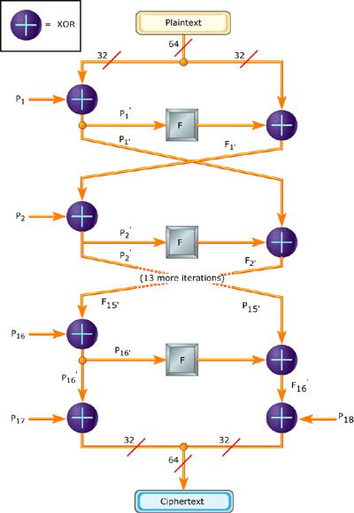
Blowfish is a symmetric encryption algorithm.
The block length for Blowfish is 64 bits.
It takes a variable-length key, from 32 bits to 448 bits

Slide 18
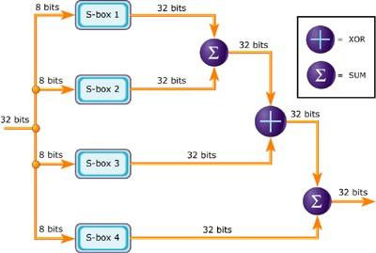
Detailed View

Slide 19
Requirements:
Blowfish requires about 5KB of memory. A careful implementation on a 32-bit processor can encrypt or decrypt a 64-bit message in approximately 12 clock cycles.
Longer messages increase computation time in a linear fashion; for example, a 128-bit message takes about (2 x 12) clocks. Blowfish works with keys up to 448 bits in length.

Slide 20
Products that use Blowfish
Password Management:
Access Manager
Java PasswordSafe
Web Confidential
File/Disk Encryption:
GnuPG
Bcrypt
CryptoForge

Slide 21
Backup Tools:
Symantec NetBackup
Backup for Workgroups
Email Encryption:
A-Lock
SecuMail
Operating System Examples:
Linux
OpenBSD
Secure Shell (SSH):
OpenSSH
PuTTY

Slide 22
Blowfish Vs AES
Blowfish and AES are both symmetric encryption algorithms meaning both encryption and decryption keys are the same. This also means that the same key is shared to enable secure communication.
This type of encryption is typically used for bulk data encryption. It also can be easily implemented by hardware. The main issue with symmetric encryption is that a person with the decryption key can decrypt all of the data.
Blowfish works fast due to its bulk encryption and decryption. Blowfish uses a block size of 64 bits. It is even faster than AES implemented in software, but still, it is not as effective as AES.

Slide 23
Conclusion
In this project we use ECC to generate public and private keys.
Encrypt the plain text using Blowfish and key block with Ecc public key of the receiver.
Compare the performance of Blowfish with AES.

Slide 24
References
B, S. (2011). Cloud Computing Bible. 1st ed. Wiley.
Bokefode , J., Ubale , S., Pingale , S., Karane , K., & Apate , S. (2015, May). Developing Secure Cloud Storage System by Applying AES and RSA Cryptography Algorithms with Role bases Access Control Model. International Journal of Computer Applications, 118.
Kumar, A., Hoonjae, L., Byung, G., & Anu. (2012). SECURE STORAGE AND ACCESS OF DATA IN CLOUD COMPUTING. IEEE, 336339.
M.Vijayapriya. (n.d.). security algorithm in cloud computing: overview. International Journal of Computer Science & Engineering Technology (IJCSET), 4.
Ren, Kui, Cong , W., & Qian , W. (2012). SECURITY CHALLENGES FOR THE PUBLIC CLOUD. Internet Computing, IEEE 16.1 , 69-73.
Sanjoli, S., & Jasmeet , S. (n.d.). Cloud computing security using encryption technique. IJARCET, 2(7).

